Slide 1

Block Code and Linear Code
Dr. Arup Kumar Pal
Department of Computer Science & Engineering
Indian Institute of Technology (ISM)
Dhanbad, Jharkhand-826004
E-mail: arupkrpal@gmail.com

Slide 2
Outline
Introduction
Block Code
Repetition Code
Hamming Code
Decoding Rule
Linear Code

Slide 3
Introduction
Data can be corrupted during transmission (three impairments: attenuation, distortion, noise).
Some applications require that errors be detected and corrected.
some issues related, directly or indirectly, to error detection and correction.
Types of Errors
Use of parity bit
Error Detection Versus Correction

Slide 4
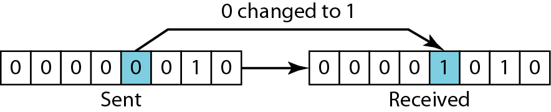
Single Bit Error
In a single-bit error, only 1 bit in the data unit has changed.
Single-bit error:

Slide 5
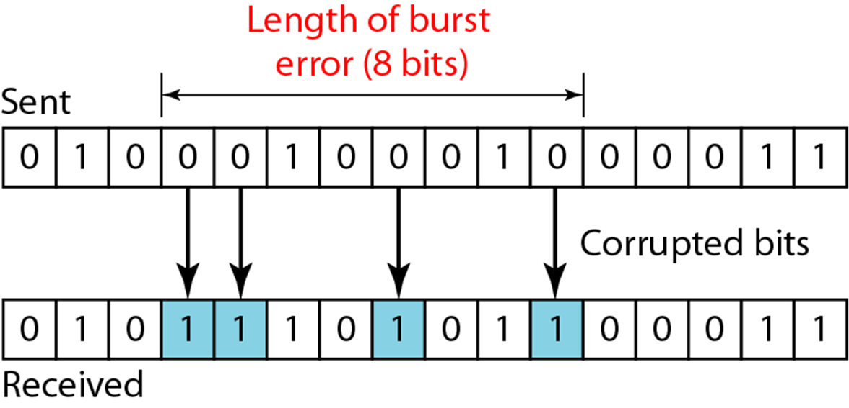
Burst Error
A burst error means that 2 or more bits in the data unit have changed.
Burst error of length 8:

Slide 6
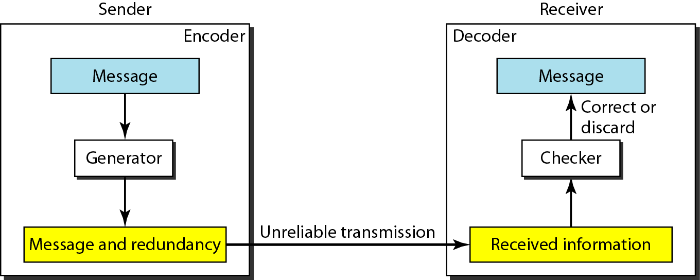
Encoder Decoder
To detect or correct errors, we need to send extra (parity) bits with data.
The structure of encoder and decoder:

Slide 7
Block Code
In block coding, we divide our message into blocks, each of k bits, called datawords. We add r parity bits to each block to make the length n = k + r. The resulting n-bit blocks are called codewords.
An odd-parity block code with 4-bit:
0 | 0 | 0 | 1
0 | 0 | 1 | 0
0 | 1 | 0 | 0
1 | 0 | 0 | 0
0 | 1 | 1 | 1
1 | 1 | 1 | 0
1 | 1 | 0 | 1
1 | 0 | 1 | 1
Codewords

Slide 8
Repetition codes
In order to transmit a message over a noisy channel that may corrupt the transmission in a few places, the idea of the repetition code is to just repeat the message several times.
The hope is that the channel corrupts only a minority of these repetitions.
This way the receiver will notice that a transmission error occurred since the received data stream is not the repetition of a single message, and moreover, the receiver can recover the original message by looking at the received message in the data stream that occurs most often.

Slide 9
Repetition Code
Repeat Information bits two or more times.
Block codes in which the parity bits are set equal to a single information bit.
If the number of parity bits is (n – 1) then the code is referred to as an (n,1) repetition code

Slide 10

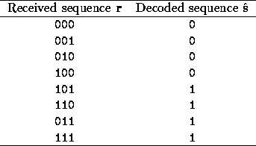
Repetition code Example
(3,1) Repetition code:
Senders Message: 0010110
Senders Message
Transmitted Sequence
Noise
Received Sequence

Slide 11
Hamming Code
Hamming Codes use the redundant bits to check the data bits using the concept of one redundant parity bit covering a number of data bits.
Bit errors can be found by identifying which parity bits are incorrect and determining which data bit was covered by those parity bits

Slide 12

Cont..
Data and redundancy bits
$$2^{r }≥k+r+1$$
Number of data bits k | Number of redundancy bits r | Total bits (k + r)
1 | 2 | 3
2 | 3 | 5
3 | 3 | 6
4 | 3 | 7
5 | 4 | 9
6 | 4 | 10
7 | 4 | 11

Slide 13

Cont..
Positions of redundancy bits in Hamming code:
$$2^{3}{,2}^{2},2^{1},2^{0}$$

Slide 14
Cont..
Redundancy bits calculation:

Slide 15
Cont..
Example of redundancy bit calculation:

Slide 16
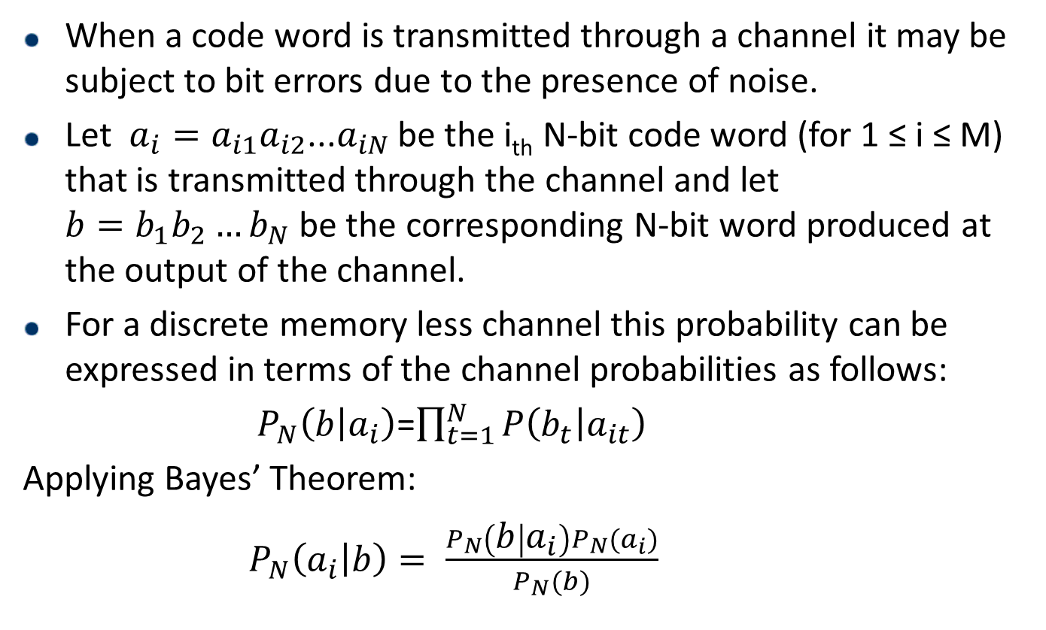
Decoding Rule
When a code word is transmitted through a channel it may be subject to bit errors due to the presence of noise.
Let $a_{i}=a_{i1}a_{i2}$...$a_{iN}$ be the i_{th} N-bit code word (for 1 ≤ i ≤ M) that is transmitted through the channel and let ${b=b}_{1}b_{2}{…b}_{N}$be the correspondingN-bit word produced at the output of the channel.
For a discrete memory less channel this probability can be expressed in terms of the channel probabilities as follows:
$P_{N}\left(b | a_{i}\right)$=$\prod_{t=1}^{N}{P\left(b_{t} | a_{it}\right)}$
Applying Bayes’ Theorem:
$P_{N}\left(a_{i} | b\right)= \frac{P_{N}\left(b | a_{i}\right)P_{N}(a_{i})}{P_{N}(b)}$

Slide 17
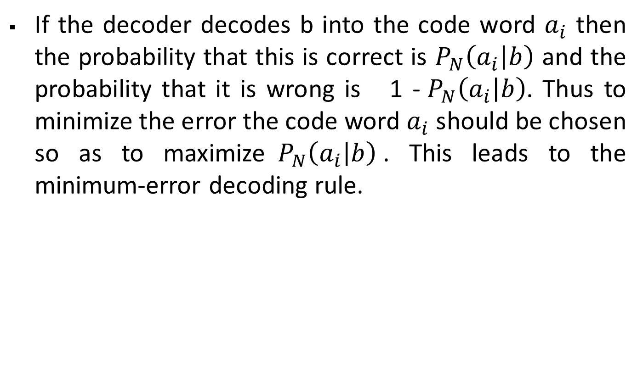
Cont..
If the decoder decodes b into the code word $a_{i}$then the probability that this is correct is $P_{N}\left(a_{i} | b\right)$ and the probability that it is wrong is 1 -${ P}_{N}\left(a_{i} | b\right)$. Thus to minimize the error the code word $a_{i}$should be chosen so as to maximize${ P}_{N}\left(a_{i} | b\right)$. This leads to the minimum-error decoding rule.

Slide 18
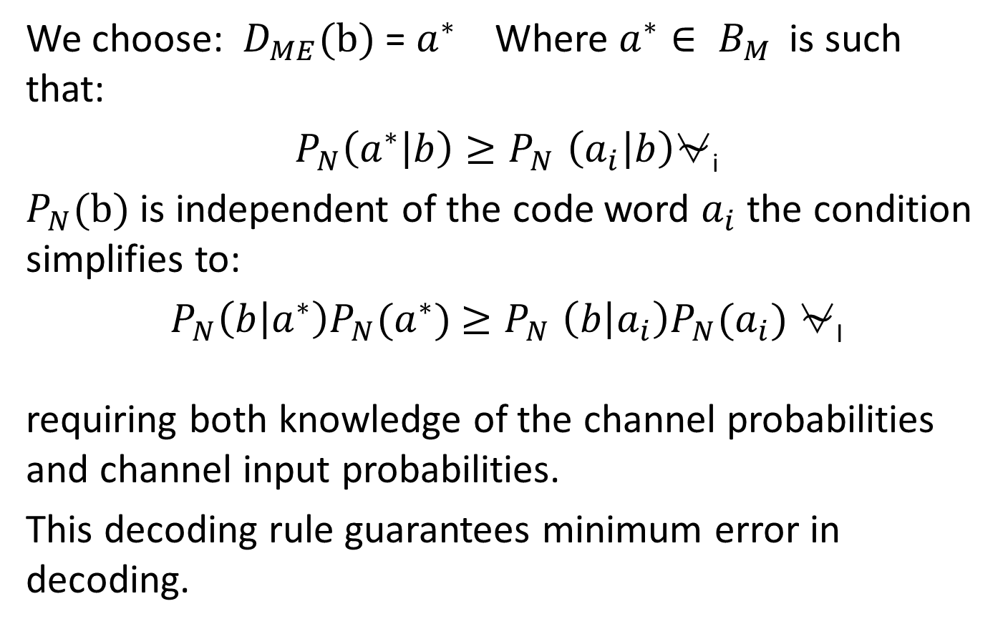
Minimum-Error Decoding Rule
We choose: $D_{ME}(b)$ = $a^{∗}$ Where $a^{∗}∈ B_{M }$ is such that:
$P_{N}\left(a^{∗} | b\right){≥P}_{N}\left(a_{i} | b\right)$⍱_{i}
$P_{N}(b)$is independent of the code word $a_{i}$the condition simplifies to:
$P_{N}\left(b | a^{∗}\right)P_{N}(a^{∗})$${≥P}_{N}\left(b | a_{i}\right)P_{N}(a_{i})$⍱_{I}
requiring both knowledge of the channel probabilities and channel input probabilities.
This decoding rule guarantees minimum error in decoding.

Slide 19
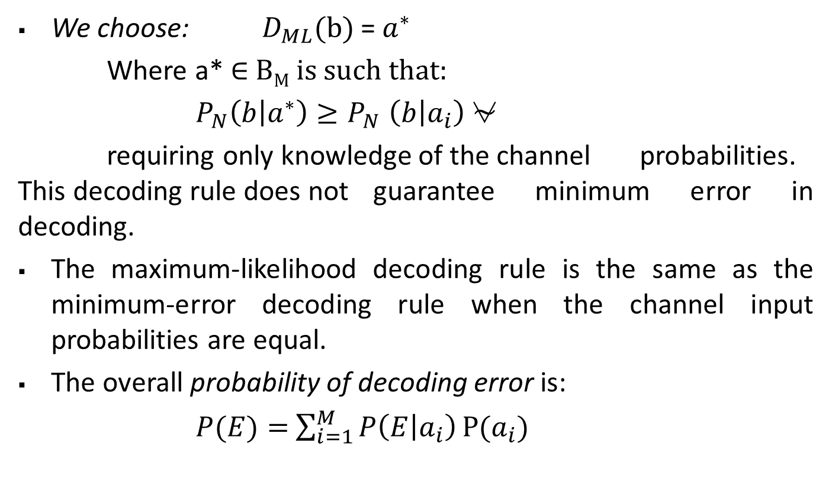
Maximum-Likelihood Decoding Rule
We choose: $D_{ML}(b)$ = $a^{∗}$
Where a* ∈ B_{M} is such that:
$P_{N}\left(b | a^{∗}\right){≥P}_{N}\left(b | a_{i}\right)$⍱
requiring only knowledge of the channel probabilities. This decoding rule does not guarantee minimum error in decoding.
The maximum-likelihood decoding rule is the same as the minimum-error decoding rule when the channel input probabilities are equal.
The overall probability of decoding error is:
$P(E)=$$\sum_{i=1}^{M}{P\left(E | a_{i}\right)}P(a_{i})$

Slide 20
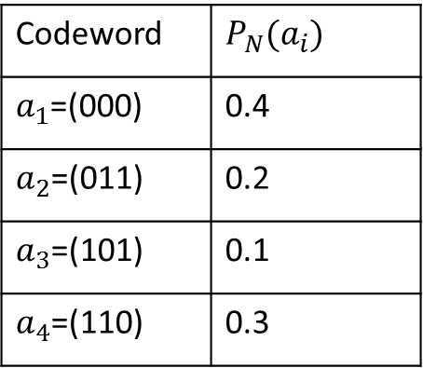

Cont...
Example:
Consider a BSC with the following channel probabilities:
P=$\left[\begin{matrix}0.6 & 0.4 \\ 0.4 & 0.6\end{matrix}\right]$
Codeword transmitted and its probability of occurrence:
Codeword | $P_{N}(a_{i})$
$a_{1}$=(000) | 0.4
$a_{2}$=(011) | 0.2
$a_{3}$=(101) | 0.1
$a_{4}$=(110) | 0.3

Slide 21
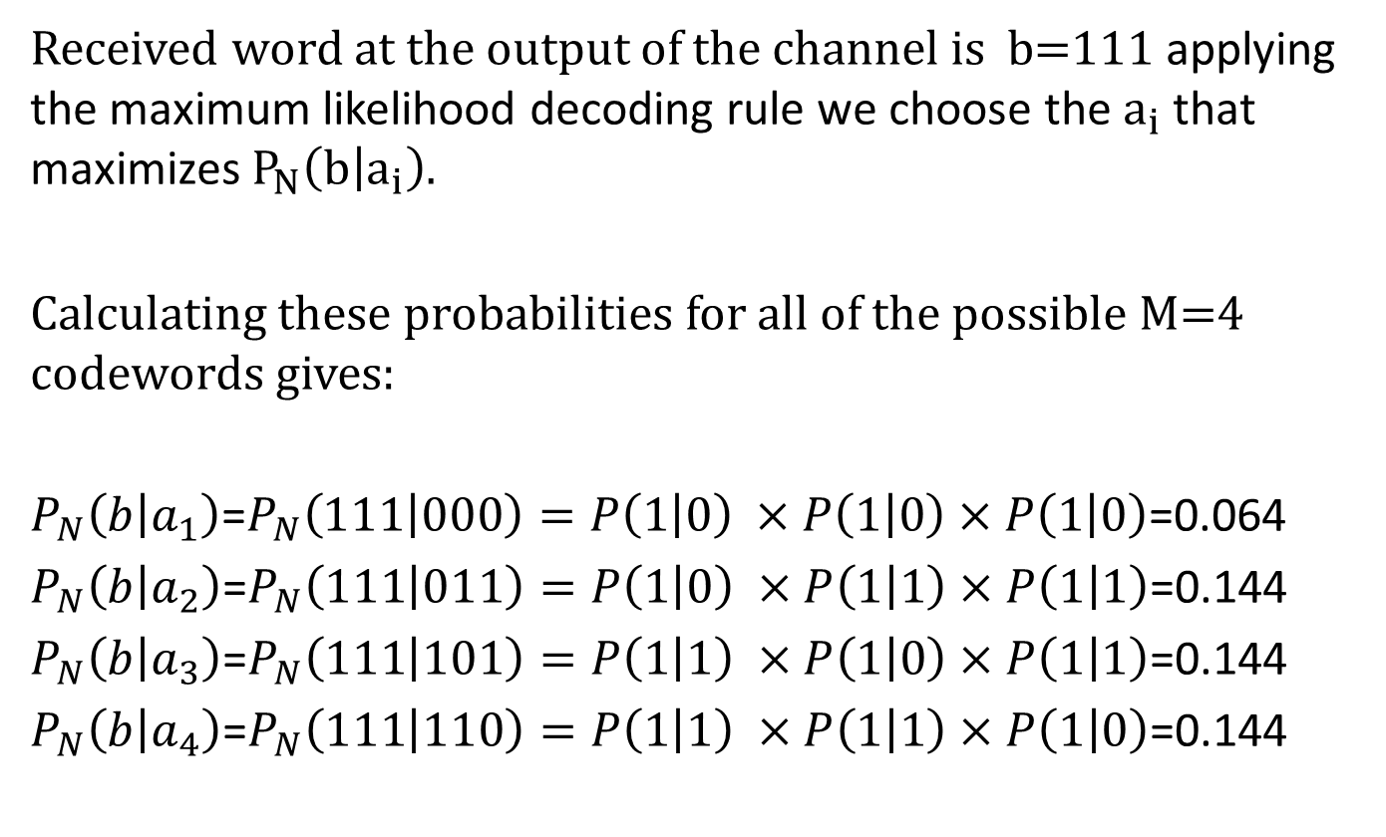
Cont...
Received word at the output of the channel is b=111 applying the maximum likelihood decoding rule we choose the $a_{i}$that maximizes $P_{N}\left(b | a_{i}\right)$.
Calculating these probabilities for all of the possible M=4 codewords gives:
$P_{N}\left(b | a_{1}\right)$=$P_{N}\left(111 | 000\right)=P\left(1 | 0\right) ×P\left(1 | 0\right)×P\left(1 | 0\right)$=0.064
$P_{N}\left(b | a_{2}\right)$=$P_{N}\left(111 | 011\right)=P\left(1 | 0\right) ×P\left(1 | 1\right)×P\left(1 | 1\right)$=0.144
$P_{N}\left(b | a_{3}\right)$=$P_{N}\left(111 | 101\right)=P\left(1 | 1\right) ×P\left(1 | 0\right)×P\left(1 | 1\right)$=0.144
$P_{N}\left(b | a_{4}\right)$=$P_{N}\left(111 | 110\right)=P\left(1 | 1\right) ×P\left(1 | 1\right)×P\left(1 | 0\right)$=0.144

Slide 22
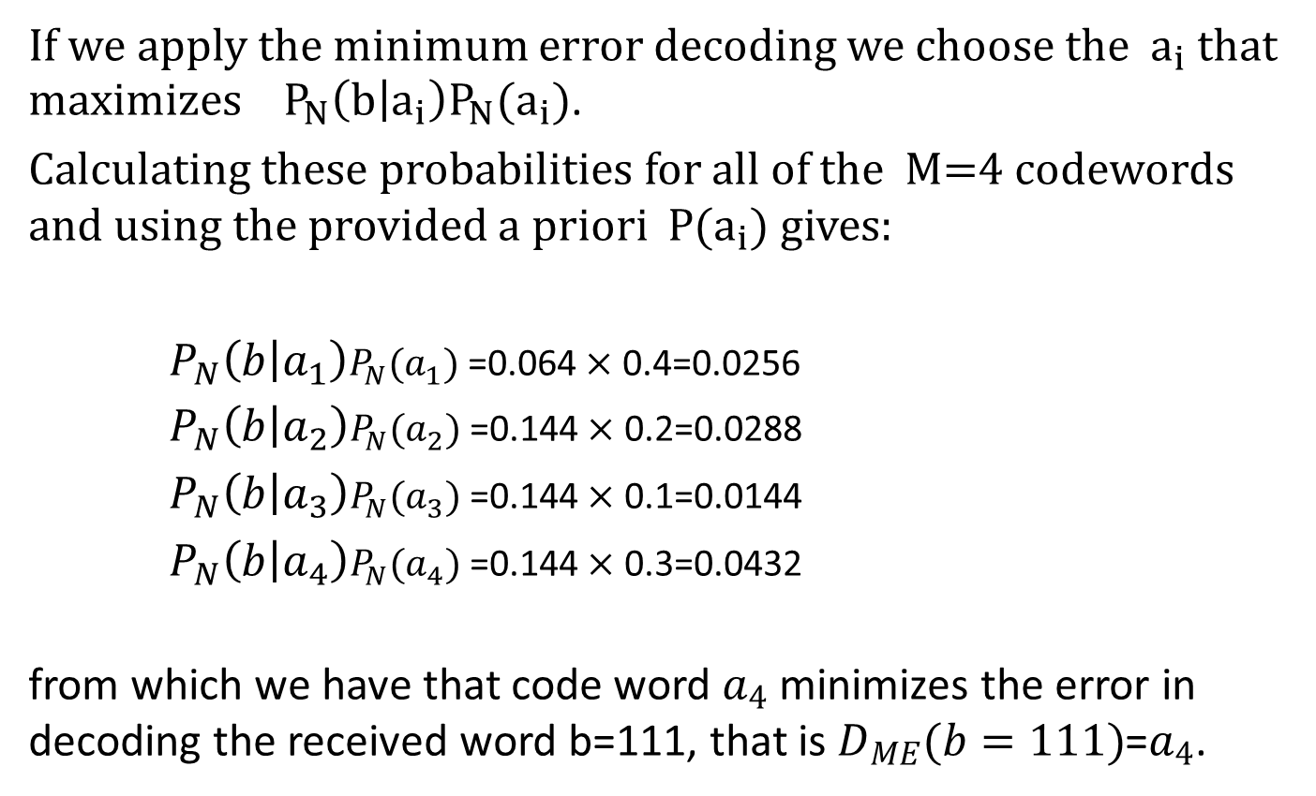
Cont...
If we apply the minimum error decoding we choose the $a_{i}$ that maximizes ${ P}_{N}\left(b | a_{i}\right)P_{N}(a_{i})$.
Calculating these probabilities for all of the M=4 codewords and using the provided a priori $P(a_{i})$gives:
$P_{N}\left(b | a_{1}\right)P_{N}(a_{1})$ =0.064$×$ 0.4=0.0256
$P_{N}\left(b | a_{2}\right)P_{N}(a_{2})$ =0.144$×$ 0.2=0.0288
$P_{N}\left(b | a_{3}\right)P_{N}(a_{3})$ =0.144$×$ 0.1=0.0144
$P_{N}\left(b | a_{4}\right)P_{N}(a_{4})$ =0.144$×$ 0.3=0.0432
from which we have that code word $a_{4}$minimizes the error in decoding the received word b=111, that is $D_{ME}(b=111)$=$a_{4}$.

Slide 23
Hamming Weight & Distance
The concept of closeness of two codewords is formalized through the Hamming distance.
Let x and y be any two codewords in C
x = 00111 y = 11100
The Hamming weight of a codeword is defined as the number of nonzero elements
w(x) = w(00111) = 3 w(y) = w(11100) = 3
The Hamming distance between two codewords is defined as the number of places in which they differ
d(x,y) = d(00111,11100) = 4
Hamming distance properties
d(x,y) = 0 x = y
d(x,y) = d(y,x)
d(x,z) ≤ d(x,y) + d(y,z) triangle inequality

Slide 24
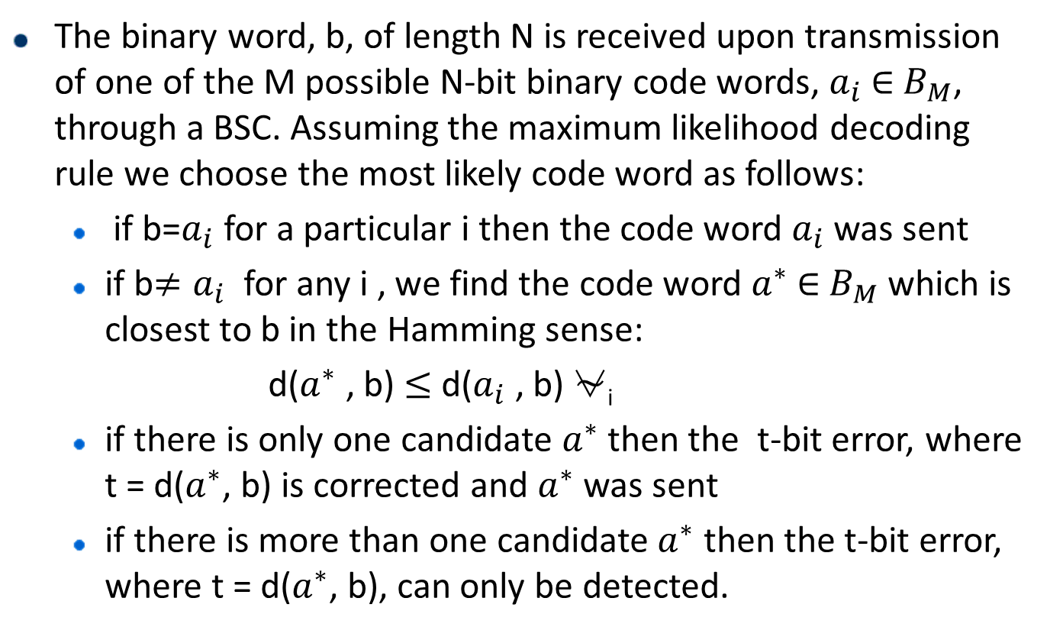
Hamming Distance Decoding Rule
The binary word, b, of length N is received upon transmission of one of the M possible N-bit binary code words, $a_{i}$ ∈${ B}_{M}$, through a BSC. Assuming the maximum likelihood decoding rule we choose the most likely code word as follows:
if b=$a_{i}$ for a particular i then the code word $a_{i}$ was sent
if b$≠a_{i}$for any i , we find the code word $a^{∗}$∈${ B}_{M}$which is closest to b in the Hamming sense:
d($a^{∗}$ , b) $≤$ d($a_{i}$ , b)⍱_{i}
if there is only one candidate $a^{∗}$then the t-bit error, where t = d($a^{∗}$, b) is corrected and $a^{∗}$was sent
if there is more than one candidate $a^{∗}$ then the t-bit error, where t = d($a^{∗}$, b), can only be detected.

Slide 25
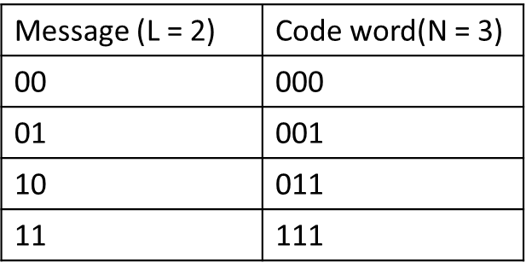
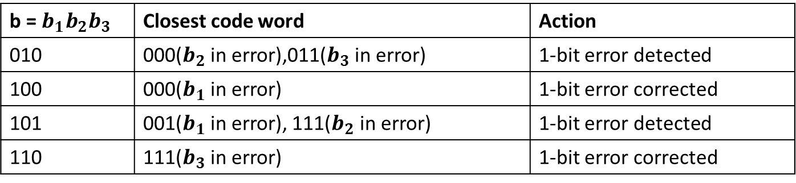
Cont..
Example:
Consider the following channel code:
If the received word, b, belongs to the set of non-codewords {000,001,011,111} then Hamming distance decoding rule would operate as follows:
b = $b_{1}b_{2}b_{3}$ | Closest code word | Action
010 | 000($b_{2}$ in error),011($b_{3}$ in error) | 1-bit error detected
100 | 000($b_{1}$ in error) | 1-bit error corrected
101 | 001($b_{1}$ in error), 111($b_{2}$ in error) | 1-bit error detected
110 | 111($b_{3}$ in error) | 1-bit error corrected

Slide 26
t-bit error detection
Error Detection Property:
A block code, K_{n} , detects up to t errors if and only if its minimum distance is greater than t: d(K_{n}) > t
Proof:
Let a* be the code word transmitted from the block code K_{n} and b the
received word. Assume there are t bit errors in the transmission. Then d(a*,b) = t.
d(b,a_{i})>0⍱i
Using the triangle inequality we have
d(a*,b)+d(b, a_{i}) ≥ d(a*, a_{i})
d(b, a_{i}) ≥ d(a*, a_{i}) – d(a*,b)
d(a*, a_{i})-d(a*,b) > 0
d(a*, a_{i}) > d(a*,b)
Since d(a*,b) = t
d(K_{n}) > t

Slide 27
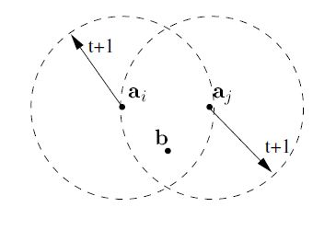
Cont...
Diagram of t-bit error detection for d(k_{n}) = t+1

Slide 28
Cont...
Error Correction Property:
A block code, K_{n}, corrects up to t errors if and only if its minimum distance is greater than 2t: d(K_{n}) > 2t
Proof:
Let a* be the code word transmitted from the block code K_{n} and b the received word. Assume there are t bit errors in the transmission. Then d(a*,b) = t.
d(a*,b) < d(a_{i},b) ⍱I
Using the triangle inequality we have
d(a*,b)+d(b, a_{i}) ≥ d(a*, a_{i})
d(b, a_{i}) ≥ d(a*, a_{i}) – d(a*,b)
d(a*, a_{i}) – d(a*,b) > d(a*,b)
d(a*, a_{i}) > 2d(a*,b)
d(K_{n}) > 2t

Slide 29
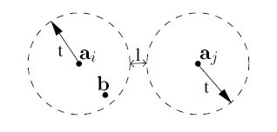
Cont...
Diagram of t-bit error correction for
d(K_{n}) = 2t+1 .

Slide 30
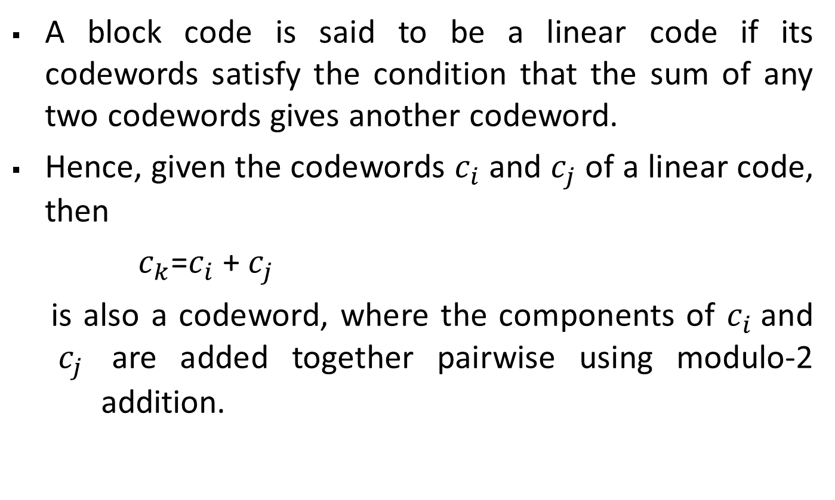
Linear Code
A block code is said to be a linear code if its codewords satisfy the condition that the sum of any two codewords gives another codeword.
Hence, given the codewords$c_{i}$ and $c_{j}$ of a linear code, then
$c_{k}$=$c_{i}$ + $c_{j}$
is also a codeword, where the components of $c_{i}$and $c_{j}$ are added together pairwise using modulo-2 addition.

Slide 31
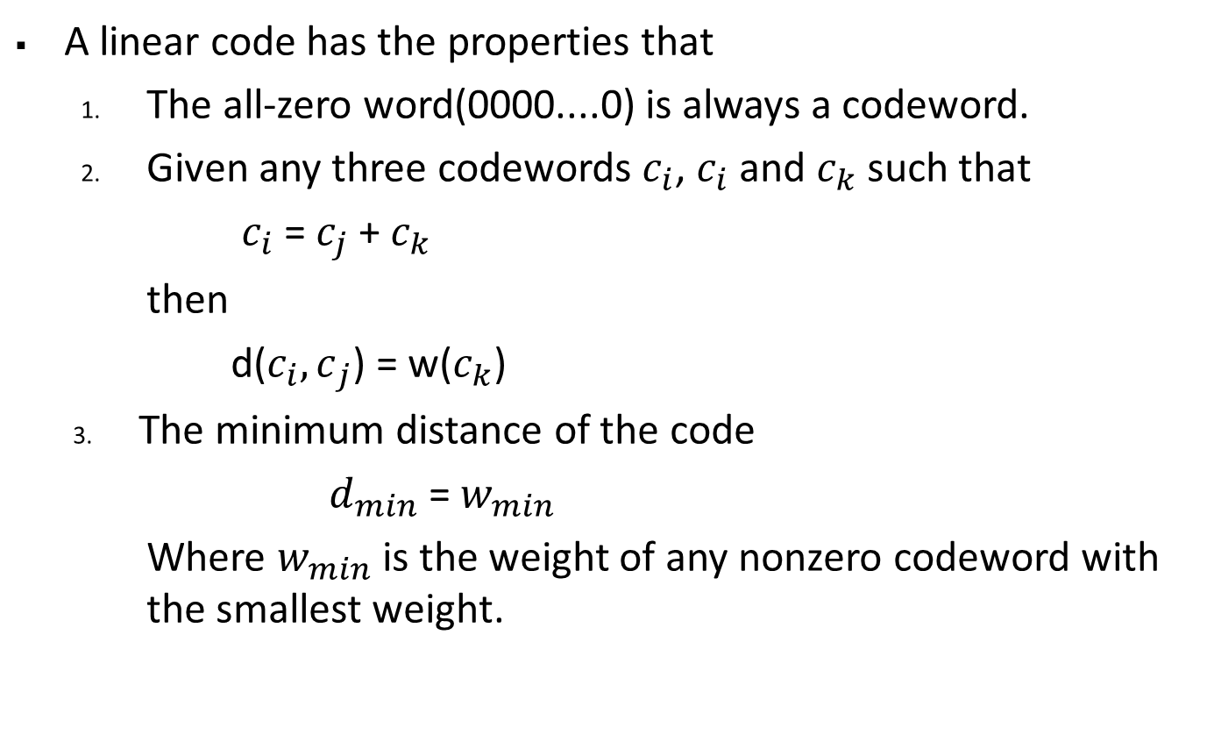
Cont..
A linear code has the properties that
The all-zero word(0000....0) is always a codeword.
Given any three codewords $c_{i}$,$c_{i}$ and $c_{k}$ such that
$c_{i}$ = $c_{j}$ + $c_{k}$
then
d($c_{i}{,c}_{j}$) = w($c_{k}$)
The minimum distance of the code
$d_{min}$ = $w_{min}$
Where $w_{min}$ is the weight of any nonzero codeword with the smallest weight.

Slide 32
Generator Matrix
The generator matrix is a compact description of how codeword's are generated from information bits in a linear block code.
All 2^{k} codewords can be generated from a set of k linearly independent codewords.
A systematic linear block code is described by a generator matrix of the form

Slide 33
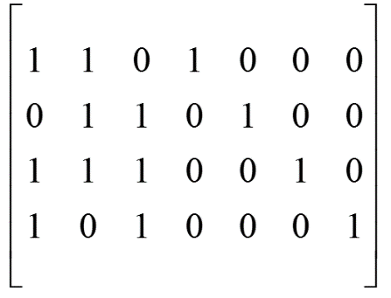
Cont..
Let m (𝑚₁, 𝑚_{2,} 𝑚_{3,} 𝑚₄) and c= (c₁, c₂, c₃, c₄, c₅, c₆, c₇)
c=m.G= (𝑚₁, 𝑚_{2,} 𝑚_{3,} 𝑚₄)
By matrix multiplication we obtain :
c₁ = 𝑚₁ + 𝑚₃ + 𝑚₄, c₂ = 𝑚₁ + 𝑚₂ + 𝑚₃, c₃= 𝑚₂ + 𝑚₃ + 𝑚₄, c₄= 𝑚₁,
c₅= 𝑚₂, c₆= 𝑚₃, c₇= 𝑚₄
The code word corresponding to the message(1110) is (0101110) .

Slide 34
The Standard Array
1.List the 2^{k} codewords in a row, starting with the all-zero codeword c₀.
2. Select an error pattern e₁ and place it below c₀. This error pattern will be a correctable error pattern, therefore it should be selected such that:
(i) It has the smallest weight possible.
(ii) It has not appeared before in the array.
3. Repeat step 2 until all the possible error patterns have been accounted for. There will always be 2^{n} / 2^{k} = 2 ^{n-k} rows in the array. Each row is called a coset. The leading error pattern is the coset leader.

Slide 35
correctable error patterns

Slide 36
Standard Array Decoding
For an (n,k) linear code, standard array decoding is able to correct exactly 2^{n-k} error patterns, including the all-zero error pattern.
Illustration 1: The (7,4) Hamming code
# of correctable error patterns = 2³ = 8
# of single-error patterns = 7
Therefore, all single-error patterns, and only single-error patterns can be corrected.

Slide 37
Cont..
Illustration 2:
The (6,3) code defined by the H matrix:

Slide 38
Cont..
Can correct all single errors and one double error pattern:

Slide 39
Parity Check Matrix
The parity check matrix is used to decode linear block codes with generator matrix G.
For G = [ P | I_{k} ], define the matrix H = [I_{n-k} | P^{T}]
(The size of H is (n-k)xn).
It follows that GH^{T} = 0.
Since c = mG, then cH^{T} = mGH^{T} = 0.

Slide 40
Cont..
Example:
Consider generator matrix of (7, 4) linear block code
H = [I^{n-k} P^{T} ] and G = [ 𝑃 𝐼_{K}]
The corresponding parity check matrix is:
1 | 0 | 0 | 1 | 0 | 1 | 1
0 | 1 | 0 | 1 | 1 | 1 | 0
0 | 0 | 1 | 0 | 1 | 1 | 1
H=
1 | 0 | 0
0 | 1 | 0
0 | 0 | 1
1 | 1 | 0
0 | 1 | 1
1 | 1 | 1
1 | 0 | 1
1 | 1 | 0 | 1 | 0 | 0 | 0
0 | 1 | 1 | 0 | 1 | 0 | 0
1 | 1 | 1 | 0 | 0 | 1 | 0
1 | 0 | 1 | 0 | 0 | 0 | 1
G. 𝐻^{T} =
= 0

Slide 41
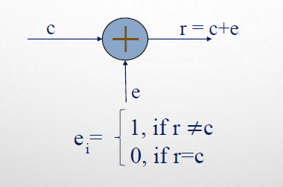
Syndrome And Error Detection
For a code word c, transmitted over a noisy channel, let r be the received vector at the output of the channel with error e
Syndrome of received vector r is given by:
s = r.H^{T} =(𝑠₁ , 𝑠₂, 𝑠₃ , … … . . , 𝑠_{n-k})

Slide 42
Cont...
Example:
Let C=(0101110) be the transmitted code and r=(0001110) be the received vector.
s=r. H^{T} =(𝑠₁, 𝑠₂, 𝑠₃)
= (𝑟₁, 𝑟₂, 𝑟₃, 𝑟₄, 𝑟₅, 𝑟₆, 𝑟₇)
The syndrome digits are:
𝑠₁ = 𝑟₁ + 𝑟₄ + 𝑟₆ + 𝑟₇ = 0
𝑠₂ = 𝑟₂ + 𝑟₄ + 𝑟₅ + 𝑟₆ = 1
𝑠₃ = 𝑟₃ + ₅ + 𝑟₆ + 𝑟₇ = 0
1 | 0 | 0
0 | 1 | 0
0 | 0 | 1
1 | 1 | 0
0 | 1 | 1
1 | 1 | 1
1 | 0 | 1

Slide 43
Cont...
Properties of syndrome:
The syndrome depends only on the error pattern and not on the transmitted word.
s = (c+e).H^{T} = c. H^{T} + e. H^{T} = e. H^{T}
All the error pattern differ by atleast a code word have the same syndrome s.

Slide 44
Cont...
The error vector, e=(𝑒₁, 𝑒_{2,} 𝑒_{3,} 𝑒_{4,} 𝑒_{5,} 𝑒_{6,} 𝑒₇) =(0100000)
C*= r + e
= (0001110)+(0100000)
= (0101110)
where C* is the actual transmitted code word.

